Slide 1


Presented by FGA ITI Academy
Indonesian Skincare Brand
Get radiantly beautiful skin the natural way.

Slide 2
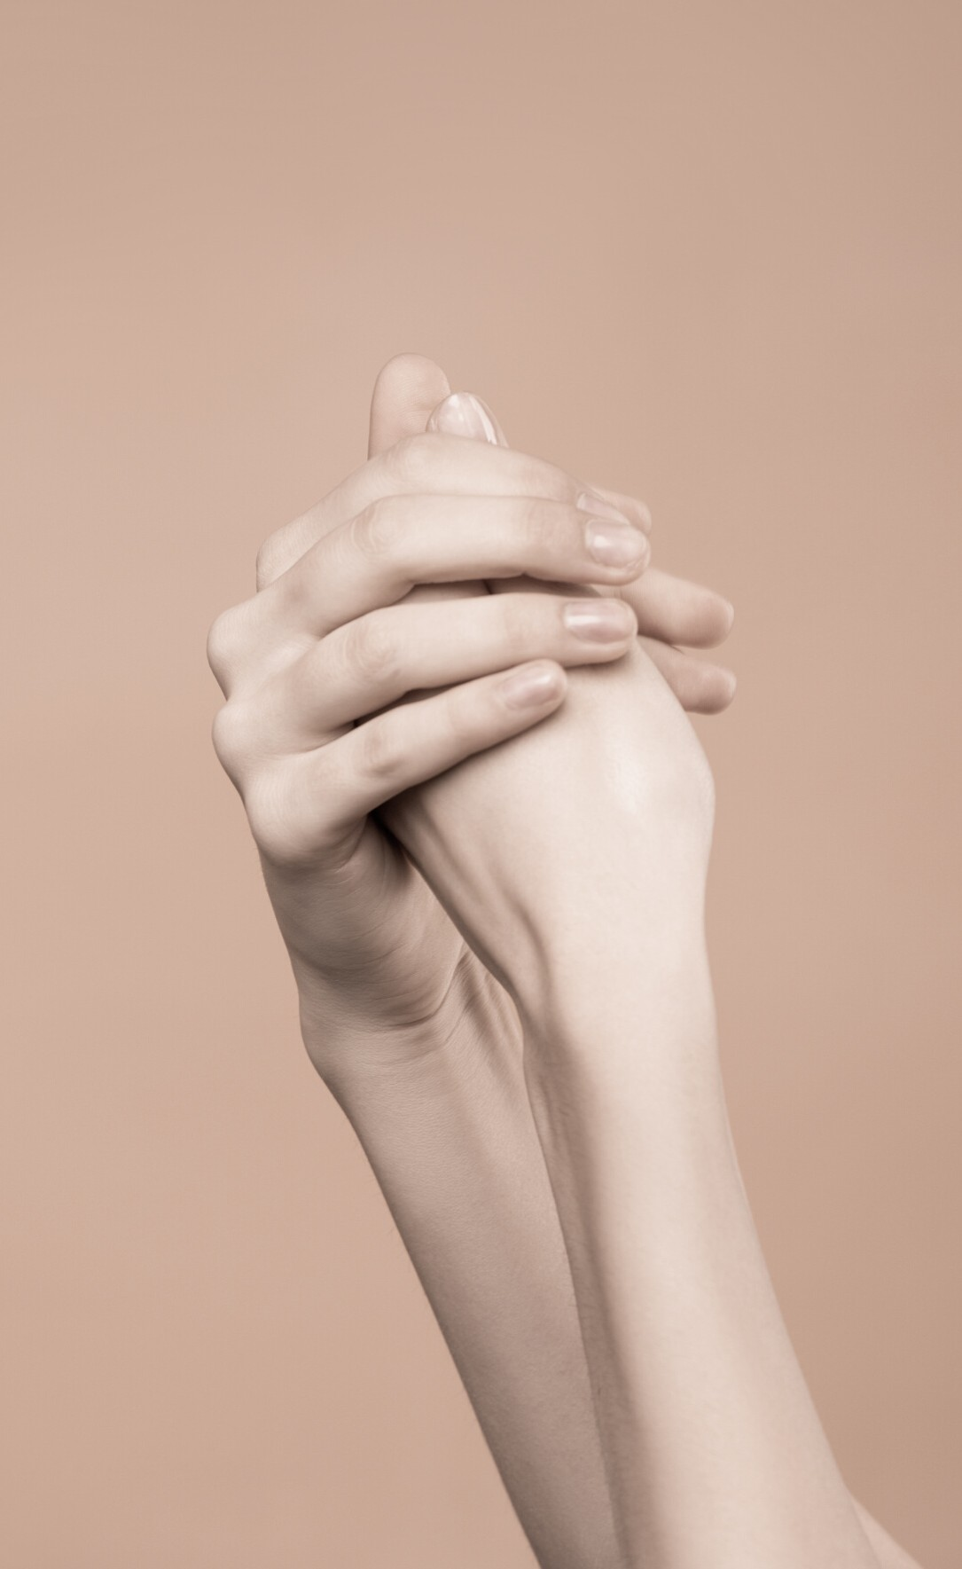
A Lifetime Investment
Invest in your skin. It is going to represent you for a very long time.
Linden Tyler

Slide 3

Our agenda today
B A C K G R O U N D
S K I N T Y P E S
S K I N C A R E B R A N D
B R A N D T R A C K
C O N C L U S I O N

Slide 4
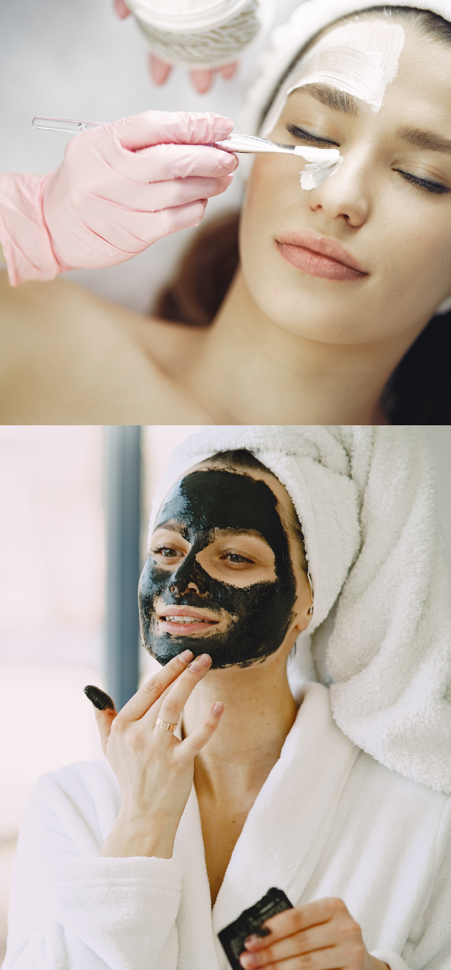

B a c k g r o u n d
From answering to a women's request to delete their insecure skin
Glowing, Shimmering, Splendid. begitulah salah satu cuitan pada kaum Millenial saat ini. mempunyai kulit yang bagus, cantik dan bersih nan bercahaya sudah tidak jadi impian. malah, terkadang dijadikan sebuah keharusan.
Pelbagai hal yang dilakukan dari filter kamera sampai kosmetik dengan harga belasan juta
Banyak yang mereview, dan hampir ribuan skin care baru merajalela di pasar saat ini. menurut analisis kami, adakah yang better or the best?

Slide 5
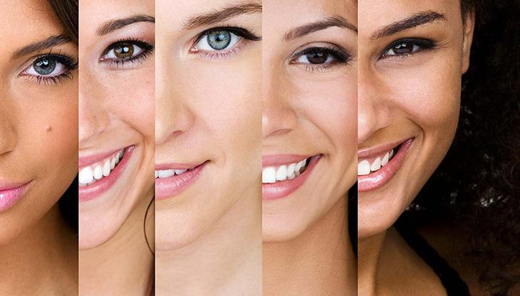
Indonesia’s Skin Type

Slide 6
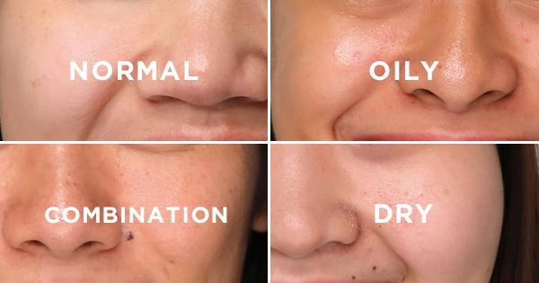
Before you start any sort of skin treatment, it is significant that you know the kind of skin you have.
Since various sorts of skin can really have totally different alternatives for legitimate purging, and keeping in mind that skin quality and type depends on hereditary qualities, it doesn’t constantly imply that you and a kin will have a similar skin type.

Slide 7
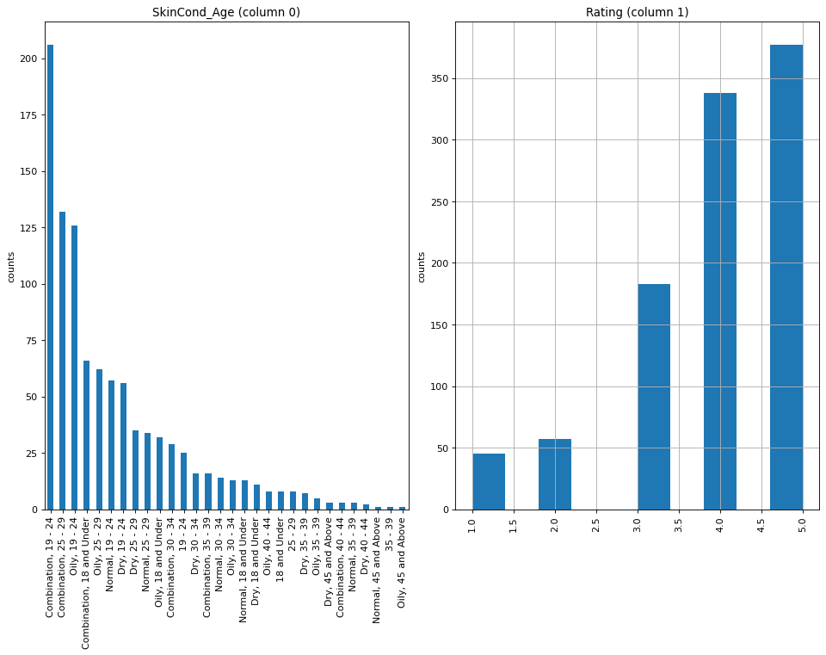
Based on data, on Indonesia’s women skin types

Slide 8

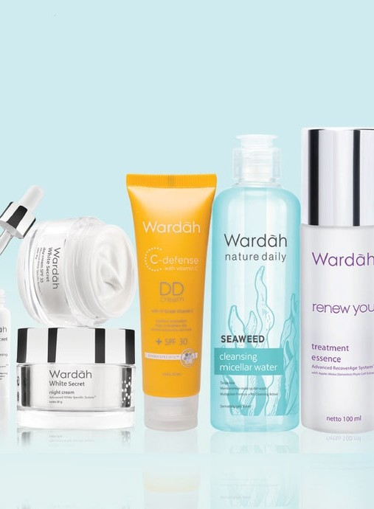
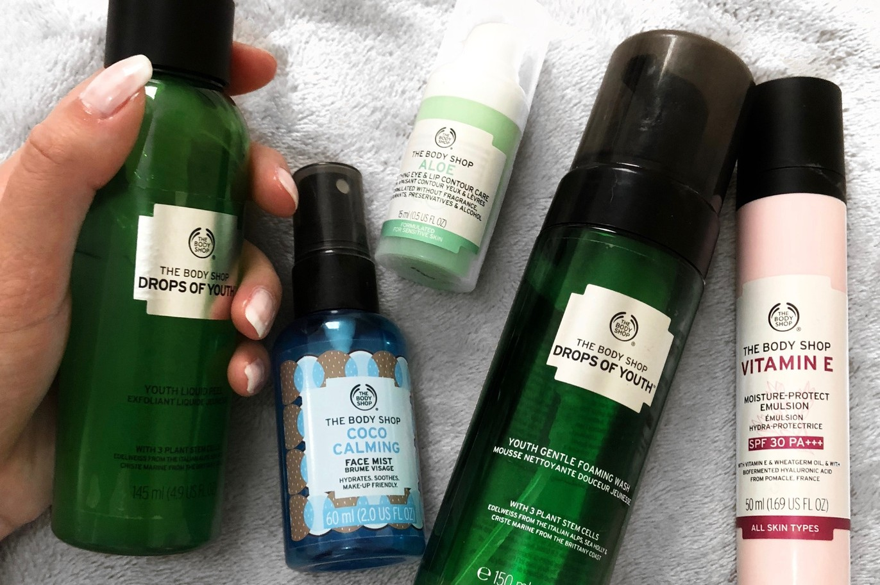
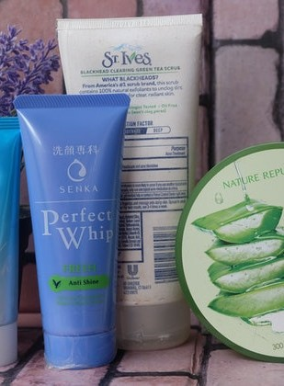
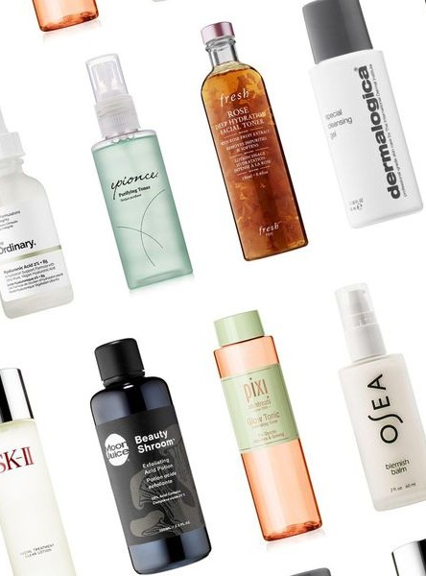
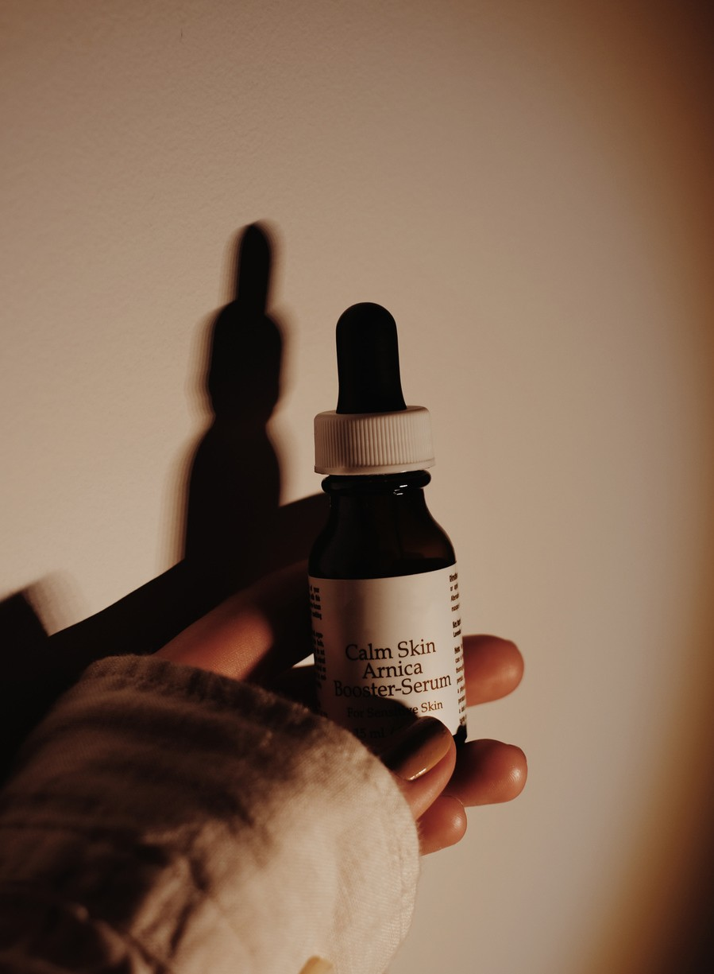
Skincare brand
we analyze
from Female daily , September 2020

Slide 9

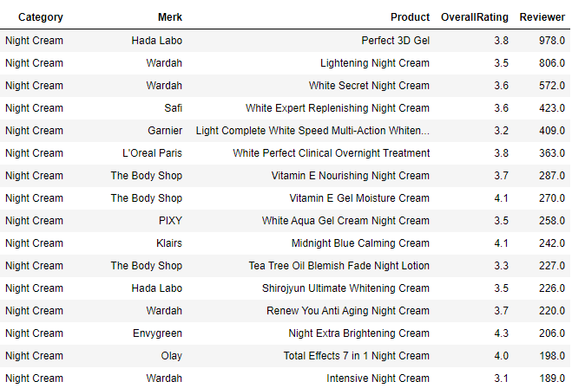
A few example of Skin Care Data Set

Slide 10
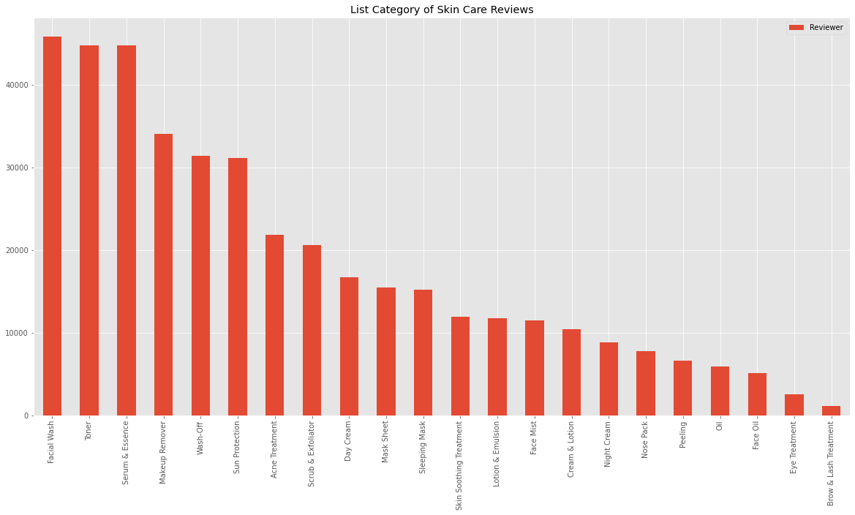

Slide 11
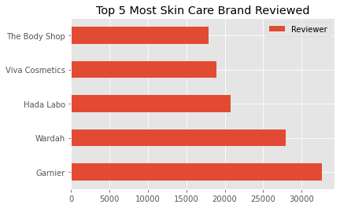

Slide 12

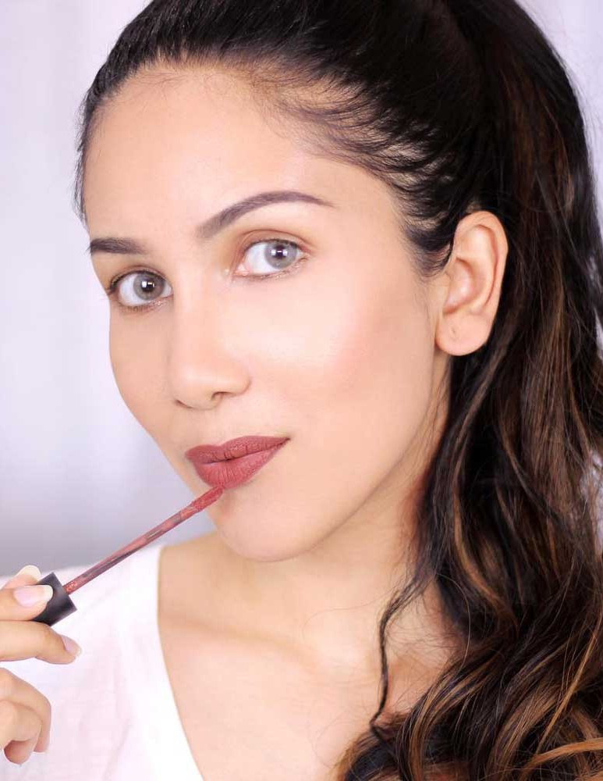
Brand Tracking
Biggest brand in Indonesia

Slide 13
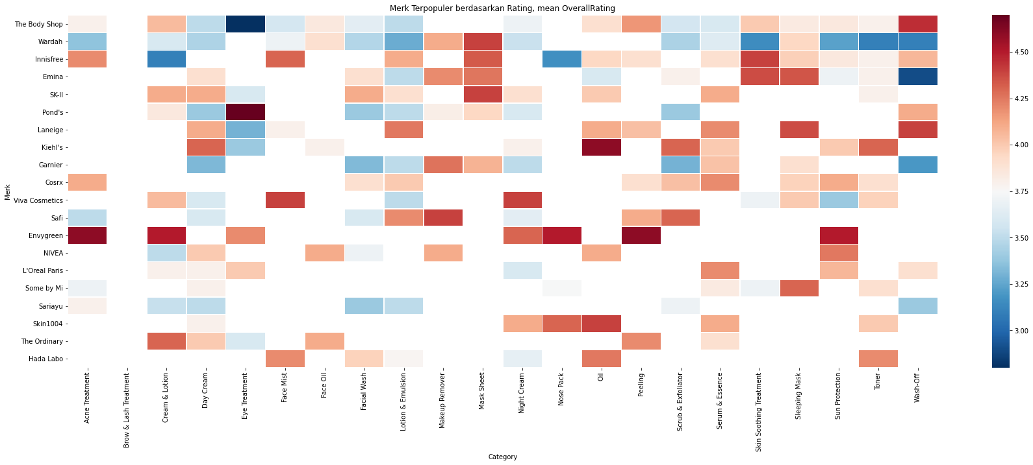
The most reviewed Merk brand on Female daily, Merk Terpopuler Berdasarkan Rata-rata Rating adalah The Body Shop diikuti Wardah

Slide 14
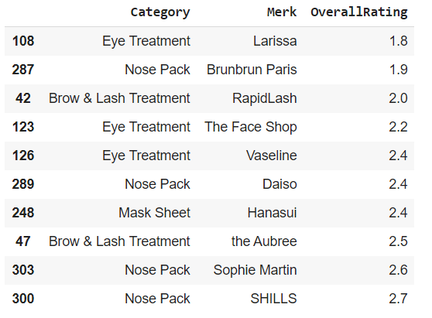
Rating terendah diduduki Merk Larissa dengan Category Eye Treatment

Slide 15
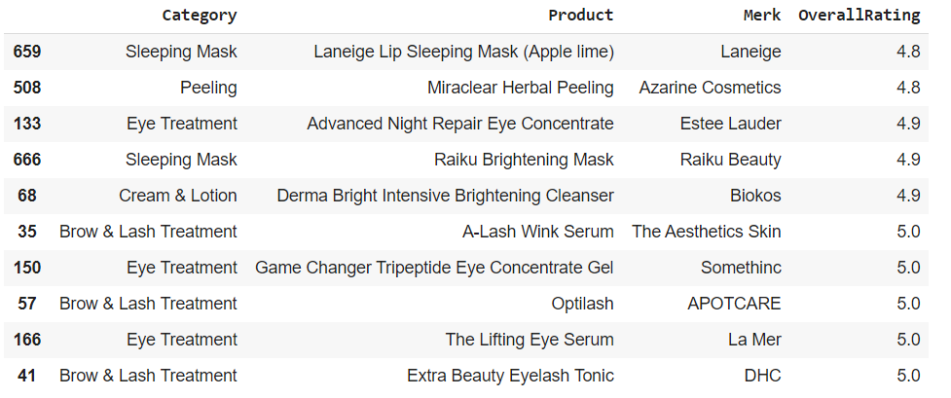
Rating tertinggi diduduki Merk DHC dengan Category Brow & Lash Treatment

Slide 16
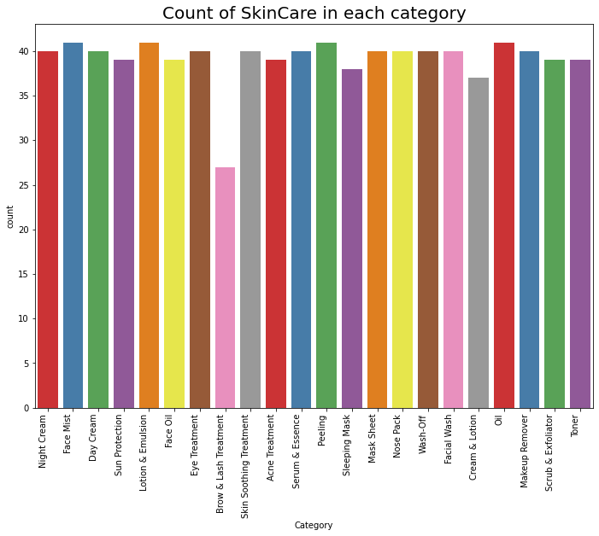
Face Mist, Lotion & Emulsion, Peeling and Oil adalah kategori Skincare yang banyak diproduksi/ beredar > 40 dan Brow and Lash Treatment adalah Category Skincare yang sedikit < 30

Slide 17

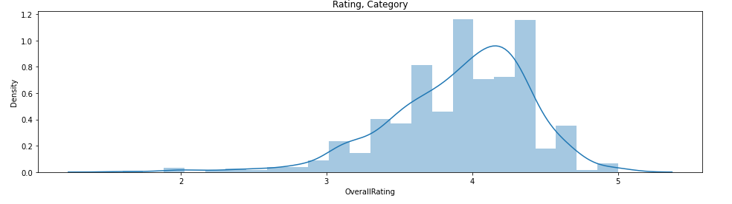
Rata - rata rating review mencapai angka 4

Slide 18
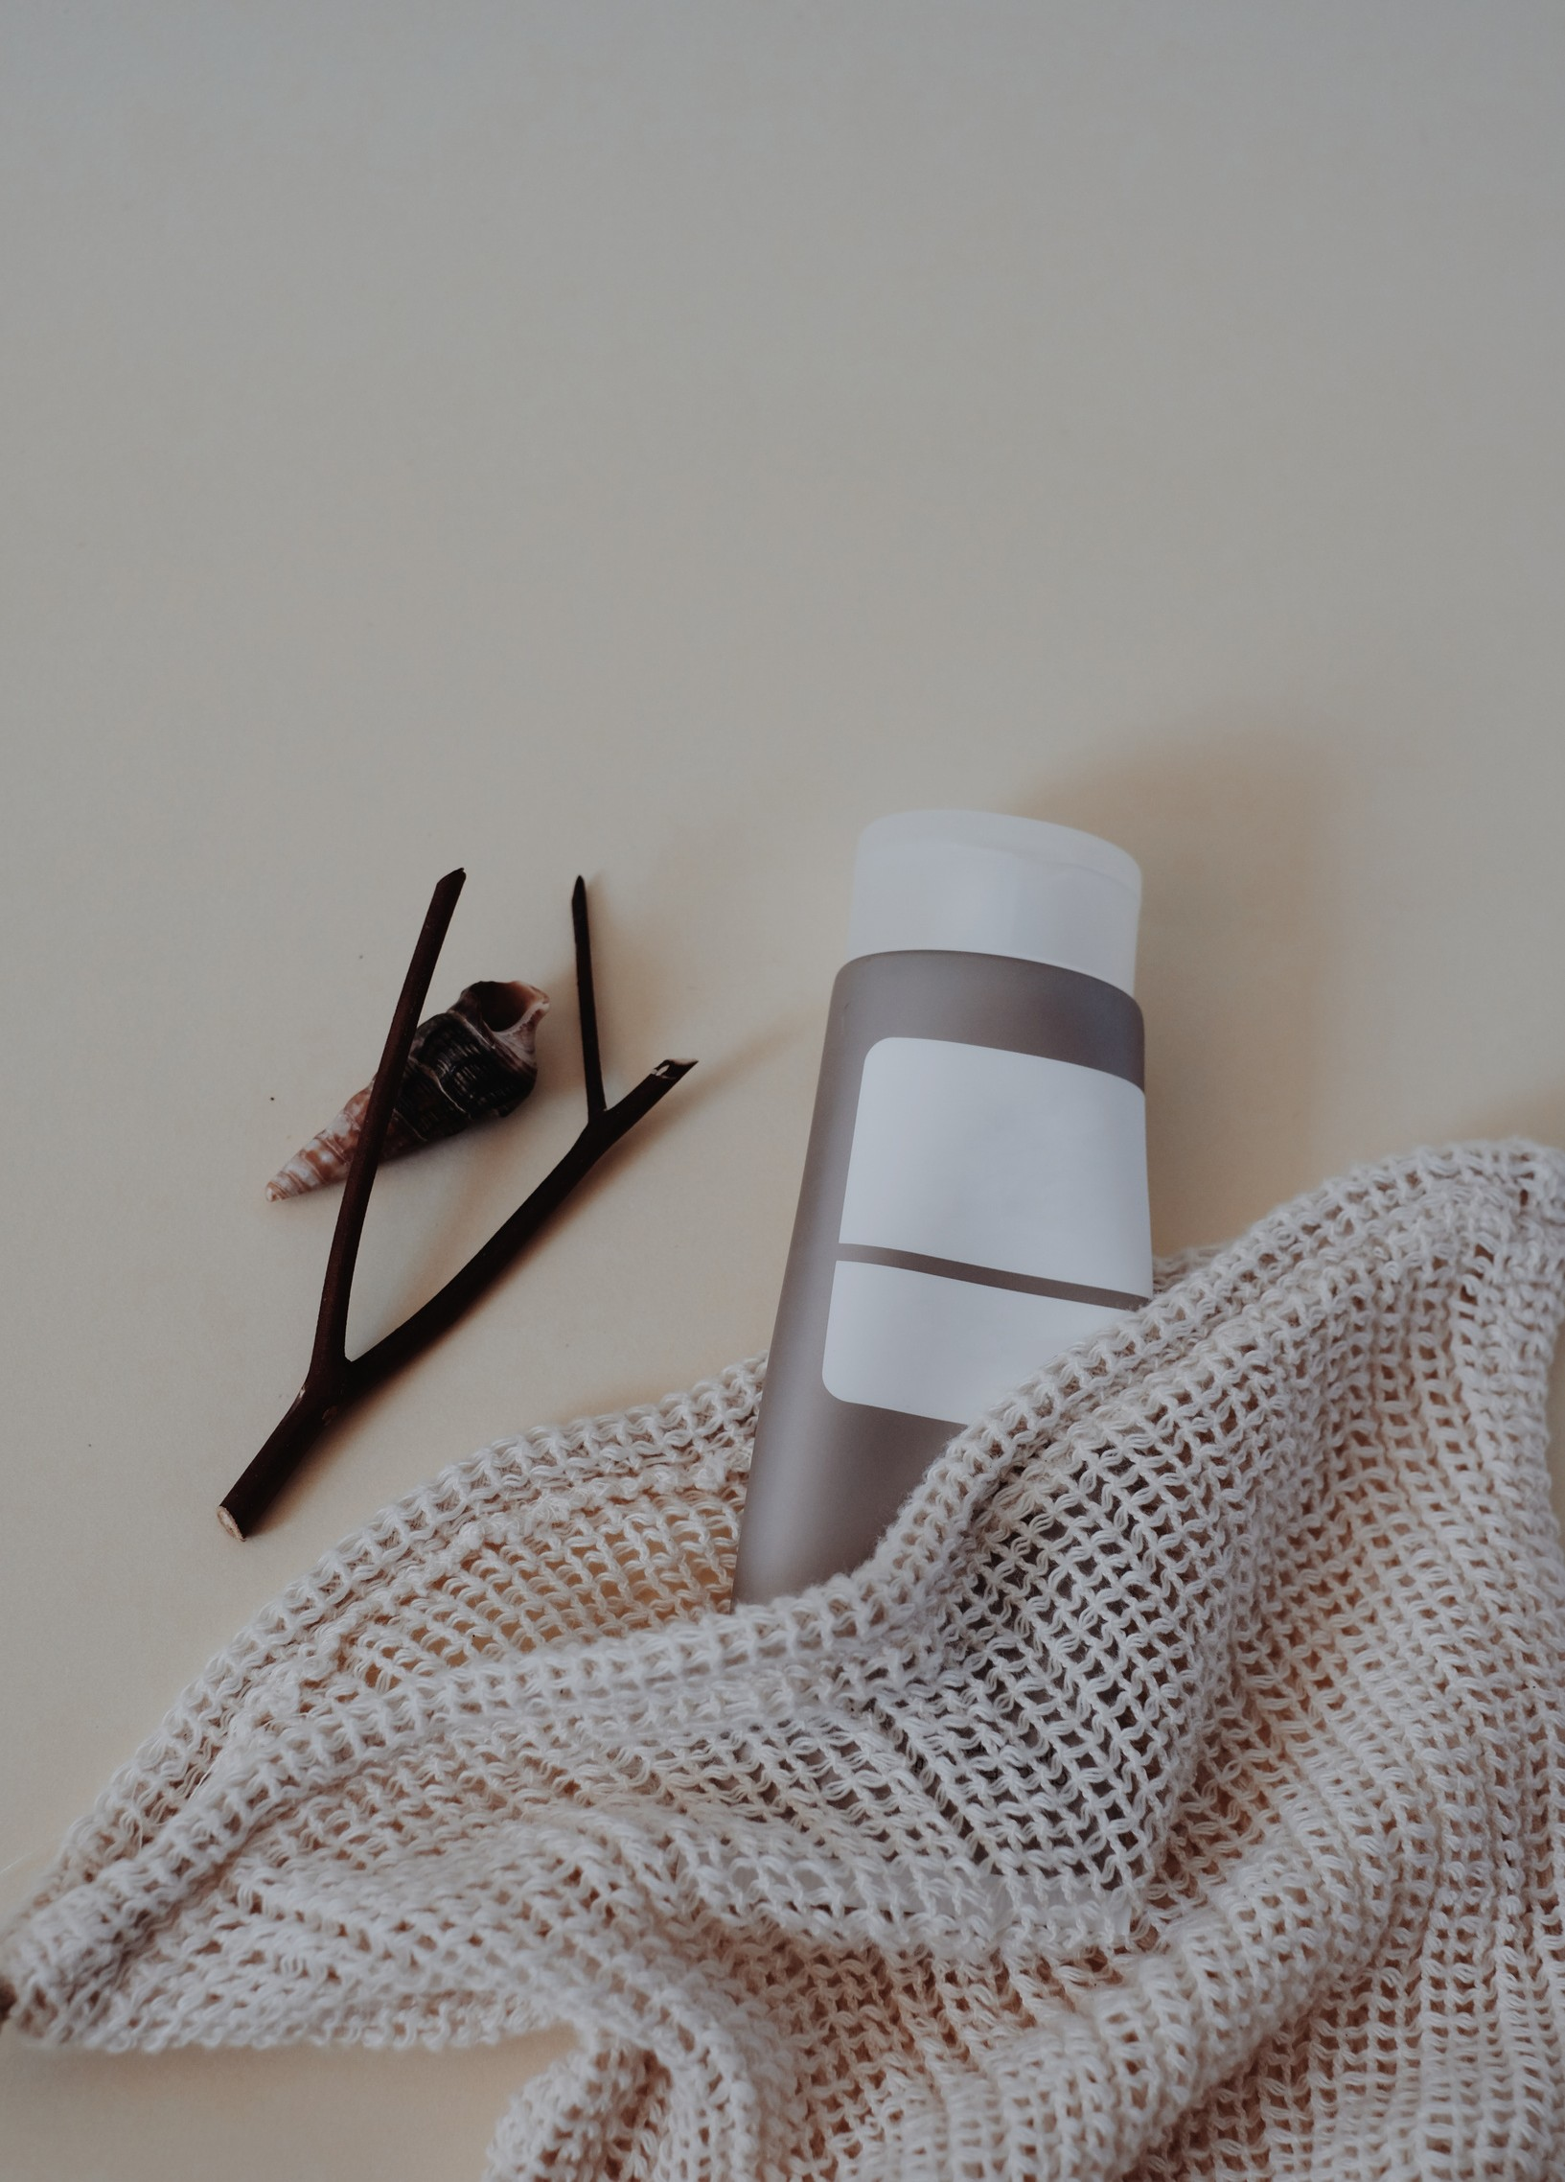
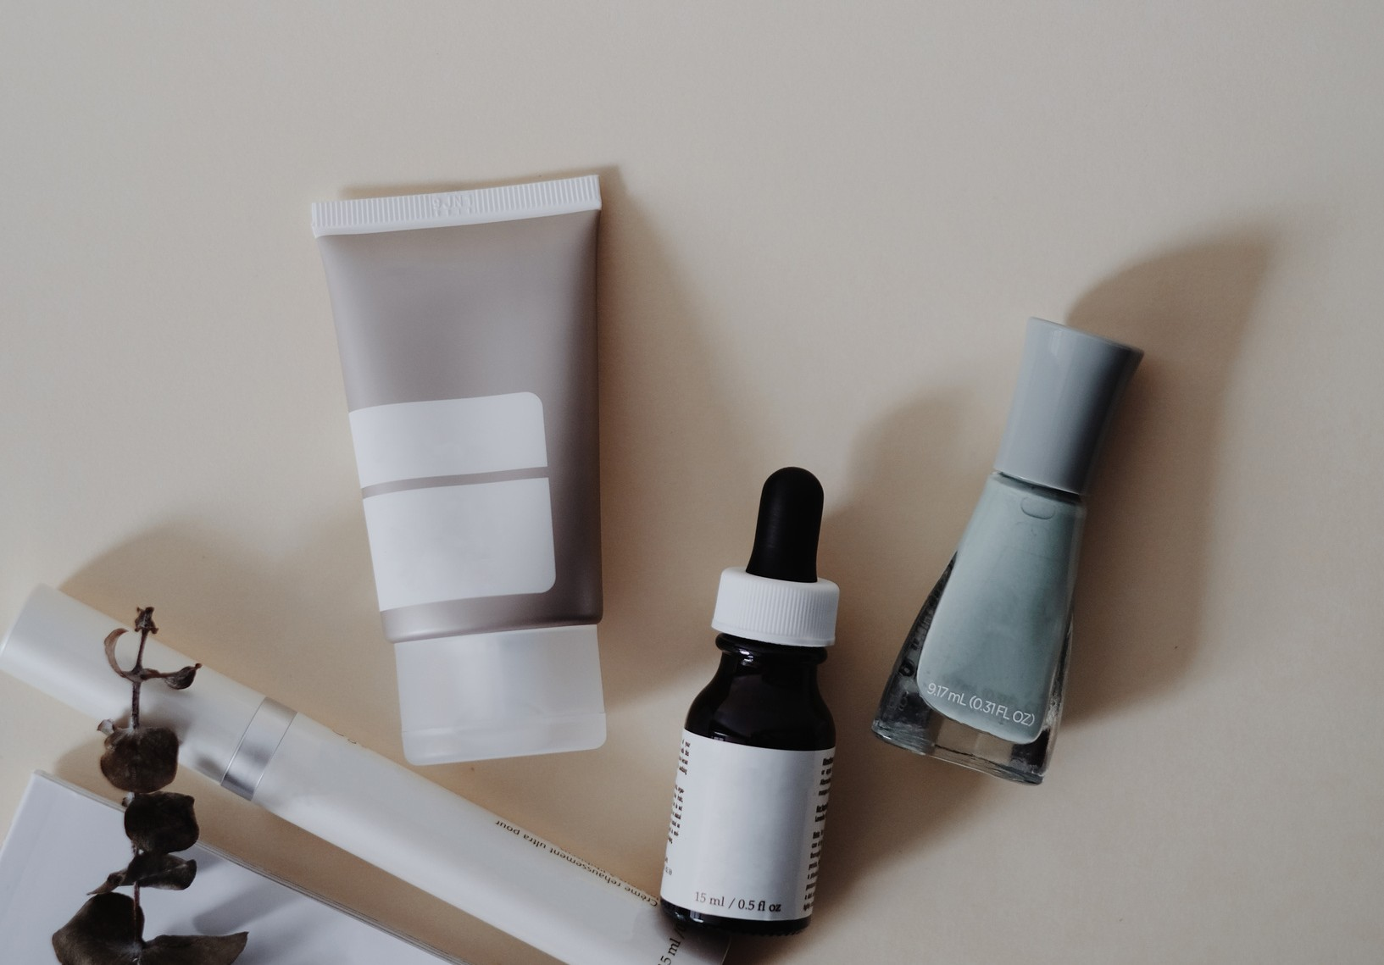
Conclusion
Exfoliating face mask that exfoliate your inner peace

Slide 19
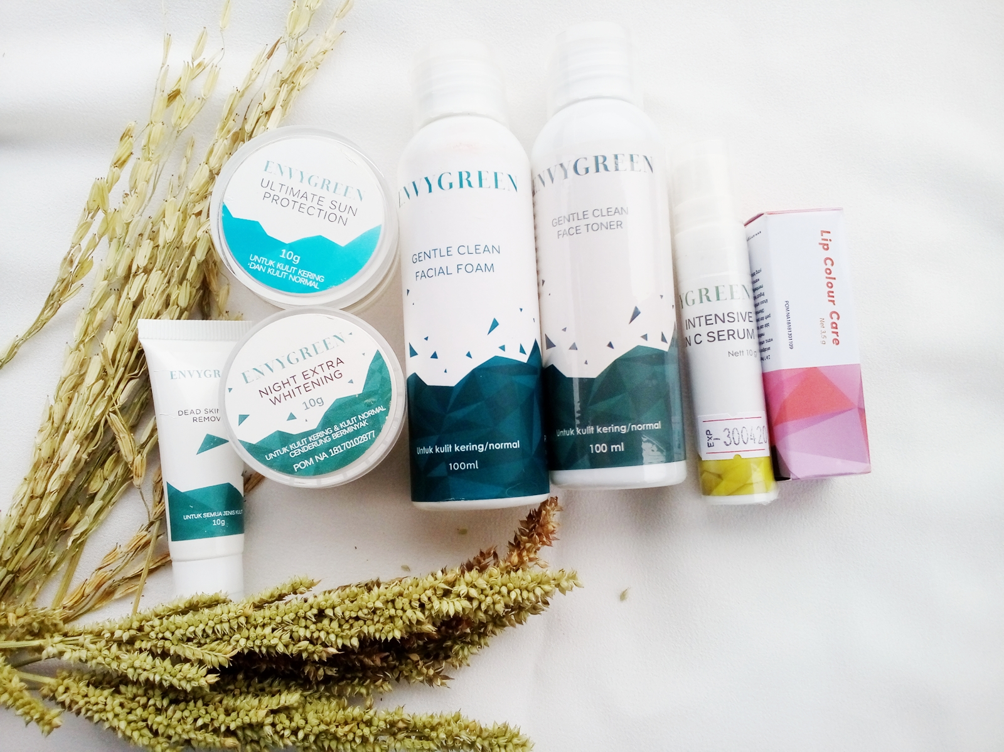
The most reviewed category is Facial Wash with total 45,808 reviewers and the least reviewed category is Brow & Lash Treatment with 1,142 reviewers.
The Most Popular Brand with Category Based on Average Rating is The Body Shop followed by Wardah
Face Mist, Lotion & Emulsion, Peeling and Oil are categories of Skincare that are widely produced / circulated and Brow and Lash Treatment is a category of Skincare that has few brand

Slide 20
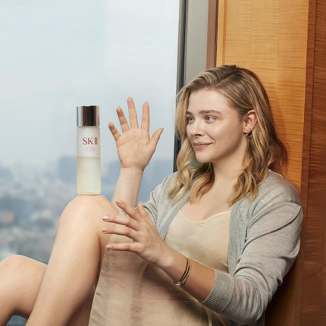

Brand with many reviewer with high rating was
1. Envygreen in Acne treatment
2. Envygreen in Cream & lotion
3. Kiehl’s in Daycream
4. Pond’s di Eye Treatment
5. Viva di Facemist
6. Nivea & The ordinary in face oil
7. SK II Facial wash
8. Laneige Lotion & emulsion
9. Safi Make up remover
10. Wardah & SK II Sheet mask
11. Viva cosmetics Night cream
12. Envygreen Nosepack
13. Kiehl’s Oil
14. Envygreen Peeling
15. Kiehl’s & Safi Scrub & exfoilator
16. Laneige, cosrx, L’oreal paris Serum & essence
17. Innisfree, emina skin & smoothing treatment
18. Emina & laneige Sleeping mask
19. Envygreen Sun protection
20. Kiehl’s Toner
21. The body shop, Laneige Wash off

Slide 21
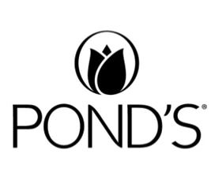

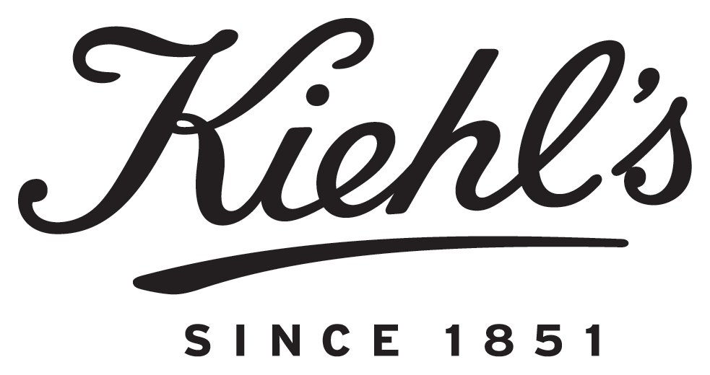
Brand dengan review rata rata overall rating
tertinggi
PONDS
EYE TREATMENT
ENVY GREEN ACNE TREATMENT
KIEHLS
OIL
ENVY GREEN PEELING

Slide 22



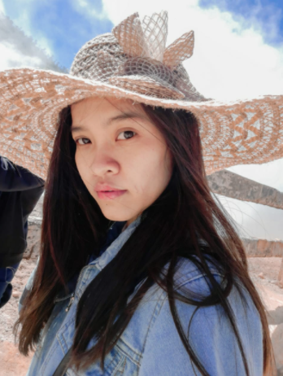


Meet Our Team
Dimas Alif
Dimas Gondho
Eka Yulia
Fiqhri Putra

